Slide 1


Pierdomenico Fiadino
The Telecommunications Research Center Vienna (ftw.)
Characterizing Web Services Provisioning via CDNs
The Case of Facebook
fiadino@ftw.at
http://userver.ftw.at/~fiadino

Slide 2



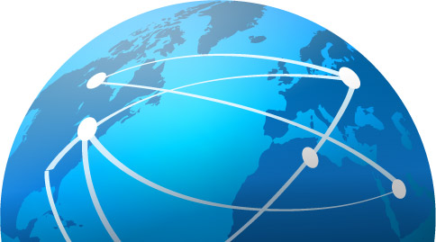



Motivations
Content Delivery Networks (CDNs) deployment is growing fast
Internet-scale services need complex provisioning systems
different organizations (i.e. hosting companies)
decentralized and geographical distributed
sophisticated load balancing policies
Characterization of such traffic delivery is an hot research topic and extremely valuable for network operators:
content caching
traffic engineering
anomaly detection and troubleshooting
This work: focus on the well known social network Facebook

Slide 3
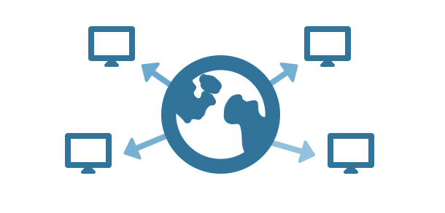
Outlook
Why Facebook
Monitoring architecture and dataset
Overview on Facebook‘s hosting infrastructure
Geographical diversity of the provisioning system
IP location through MaxMind dataset
IP distances through RTT measurements
Addressing space
Hosting companies and different rules
static vs. dynamic contents
CDN-interplay and unexpected events
Temporal characteristics of traffic

Slide 4



Why Facebook
Most popular and wide-spread Online Social Network (OSN)
Hosted by Akamai
Some numbers:
1.28 billion of active users (as of March 2014)
137.000 servers in 85 countries / 1200 networks
From our dataset:
70% of users in our dataset
10% of total traffic volume
~6000 different IP addresses
in ~250 Autonomous Systems
In ~20 countries across the globe
Facebook is the perfect study case to
understand large services’ provisioning systems

Slide 5
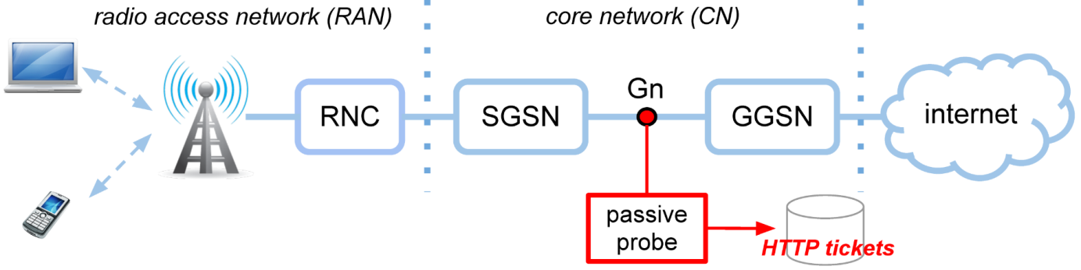
System Architecture and Dataset
Data passively collected at the mobile network of a major European operator
Dataset:
HTTP tickets (summary of HTTP connections)
One month (mid. 2013), millions of users
Stored in DBStream (streaming datawarehouse system)
Classified using the HTTPTag traffic classification tool

Slide 6
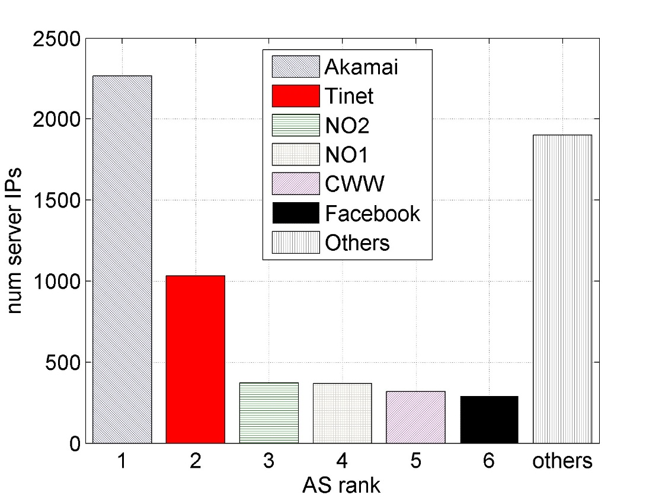
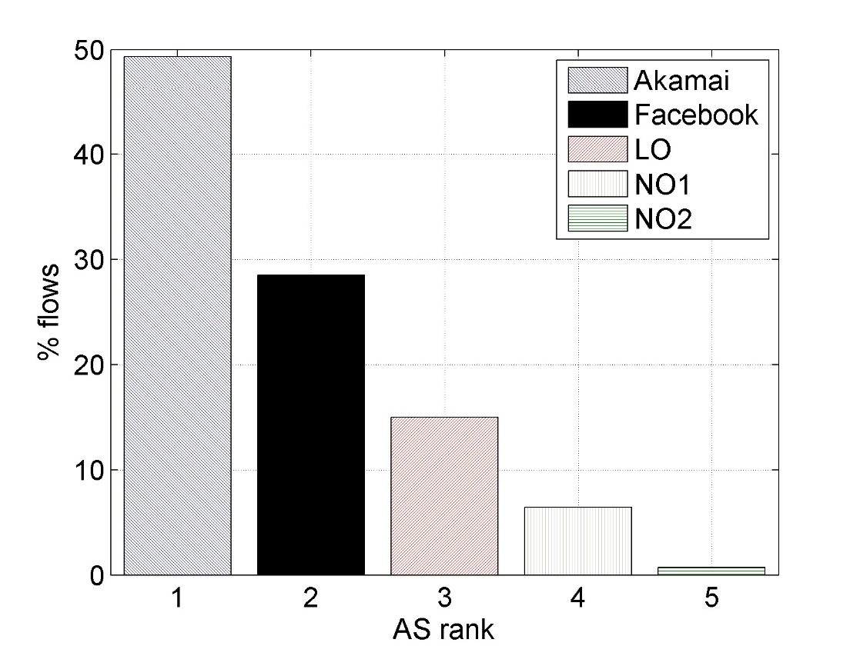

Hosting Infrastructure Overview
Number of IP addresses per A.S.
Share of flows per A.S.
Top hosting companies: Akamai, two neighbor ISPs, Tinet, Cable&Wireless
However: Akamai plays key role (50% of traffic, 2600 IP addresses)
The others: mostly caches and spurious contents

Slide 7
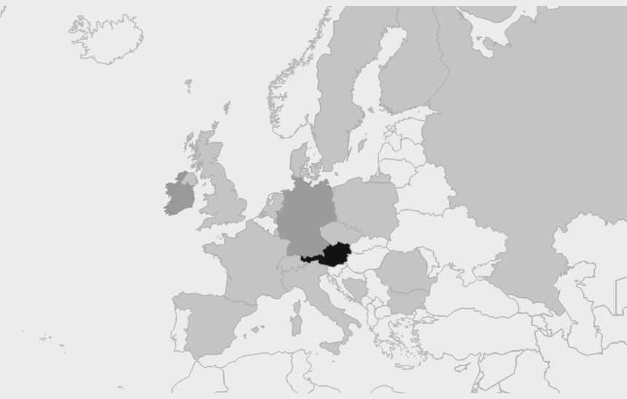


Geographical Diversity [1/2] Localizing Facebook IPs through MaxMind
Austria: 37.2%
Ireland: 12.7%
Germany 2.1%
USA: 1.1%
Europe (uncl.): 46.8%
99% traffic from within Europe
Strong content localization
Akamai Datacenters in Europe play biggest role
ISPs caching: local and neighboring countries

Slide 8
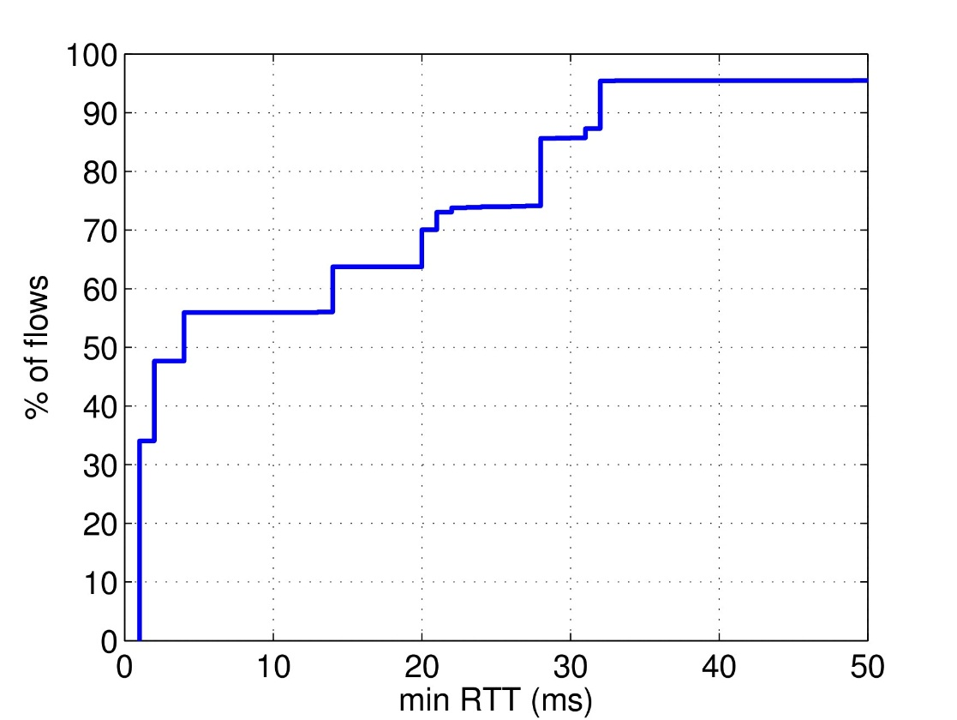
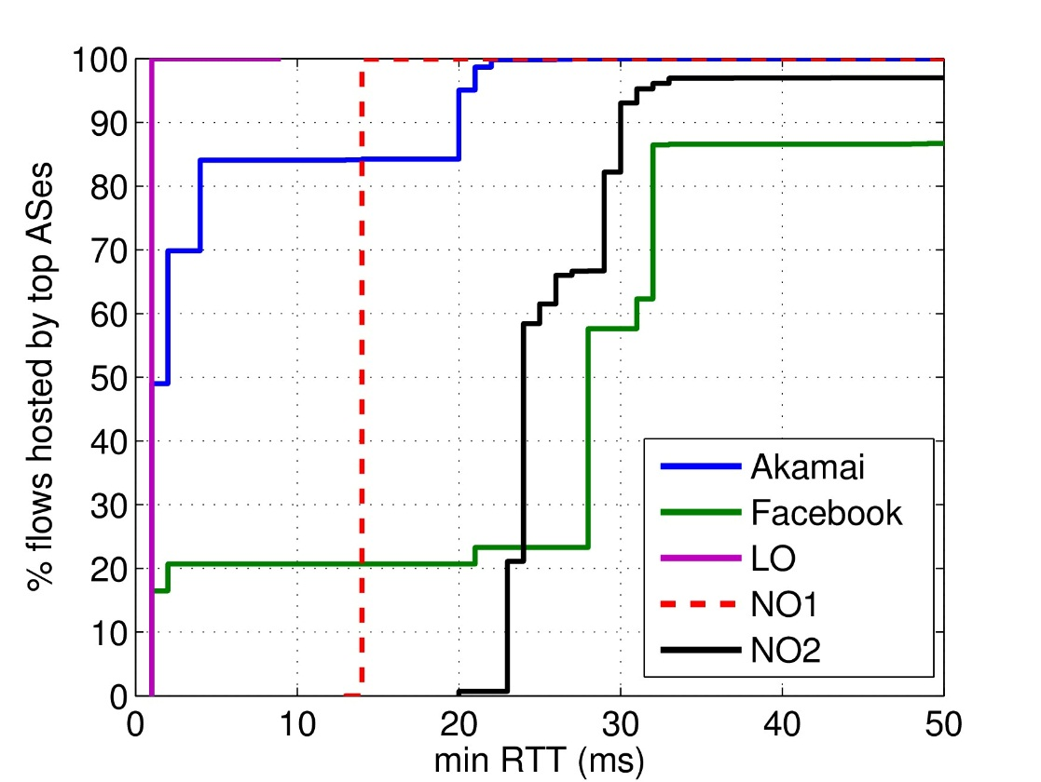
Geographical Diversity [2/2] Estimating servers distance through min RTT
minumum RTT for all server IPs
minimum RTT for top hosting A.S.
min RTT approximate value of propagation delay
Knees in the distributions correspond to different hosting locations
Akamai AS: very short RTT (highly distributed and close to final users)
Facebook AS: three knees (Ireland + locations in USA through local IXP)
Intuitively network operators have small geographical diversity

Slide 9
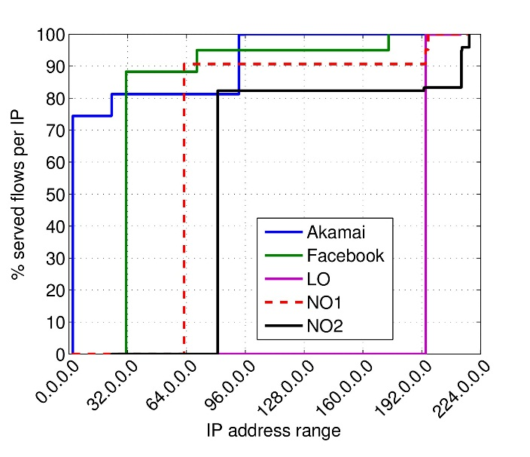
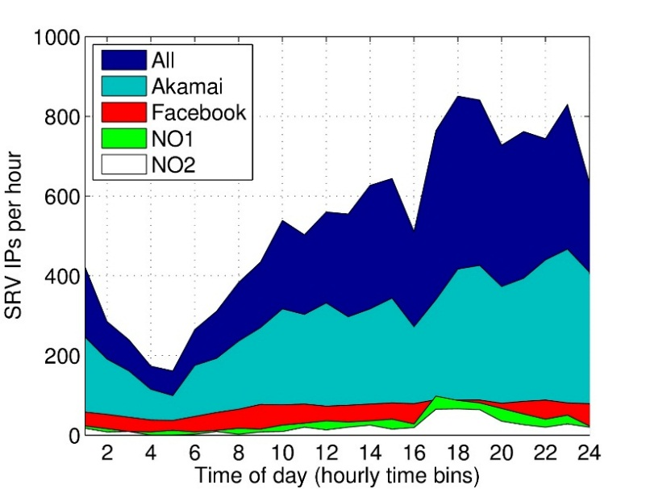
Addressing Space
Weighted distrib. of IP addr. ranges
Deployment of IPs
over a day
Akamai’s 75% of flows from a single subnet
Facebook AS’ 89% from a single range
Neighbor Operators’ 91% and 82% from a single range
Local Operator only deploys a small range of IPs
Facebook AS IPs are always active (dynamic contents)
Akamai strictly follows daily usage patterns (static contents)

Slide 10
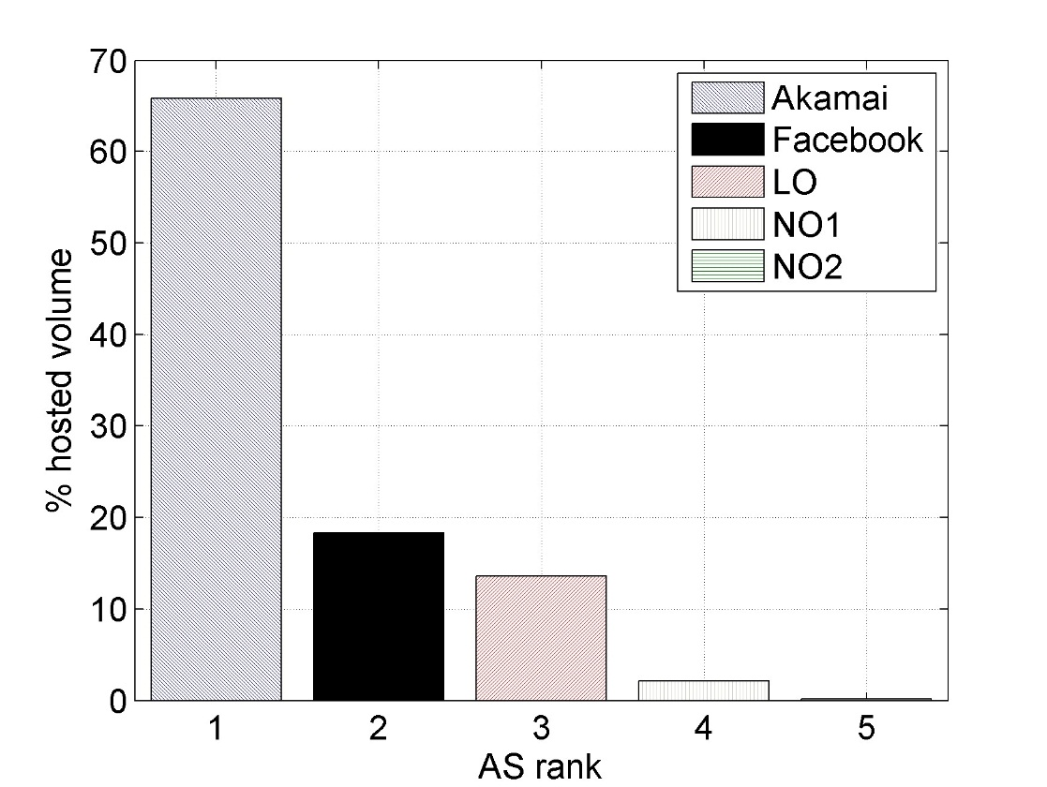
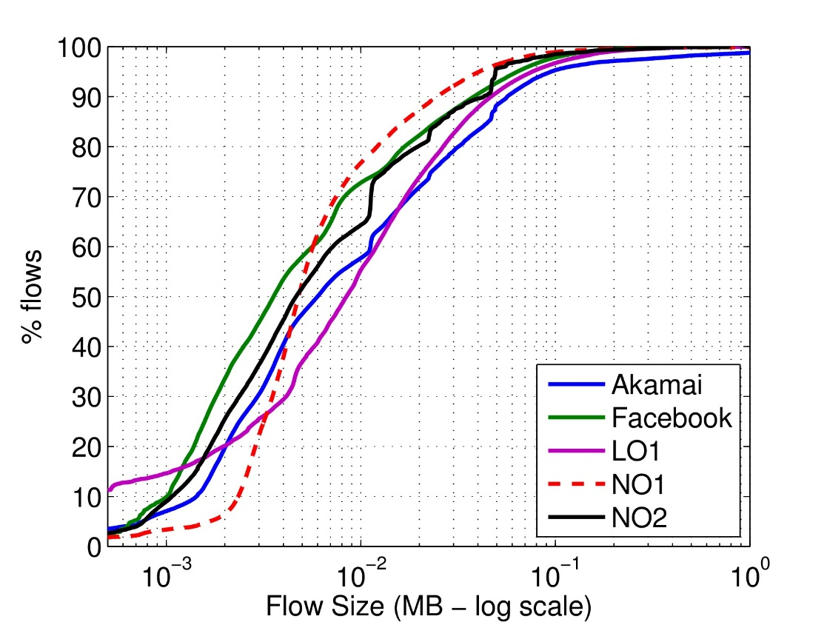
Hosting Companies and roles
ASes’ served traffic volume and distribution of flow sizes give an hint on the role of the hosting companies (hosting static/dynamic contents)
Shares of hosted volume per org/A.S.
Distribution of flow sizes
Akamai hosts more than 65% of traffic volume
Facebook AS responsible for 20% of volume
Akamai serves big flows (media/static contents)
Facebook AS dedicated to dynamic contents

Slide 11
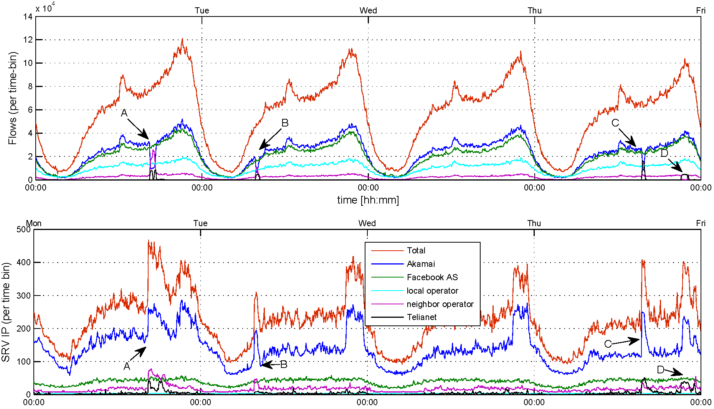
CDN Inter-play [1/3] Time Series (4 days)
Events C and D
more details in next slide
flows
Events A and B
Outage in Akamai (drop in number of served flows, active IPs)
Neighbor Operator 1and Neighbor Operator 2 deploy back-up machines (increase number of active IPs) and together take over
A
B
C & D
srv IP
CDNs have ~constant share of deployed IPs and number of flows
Facebook AS and Akamai lead the number of served flows
Akamai employs largest share of active IPs per time-bin
Notes:
Non dire anomalie: PECULIAR EVENTS

Slide 12
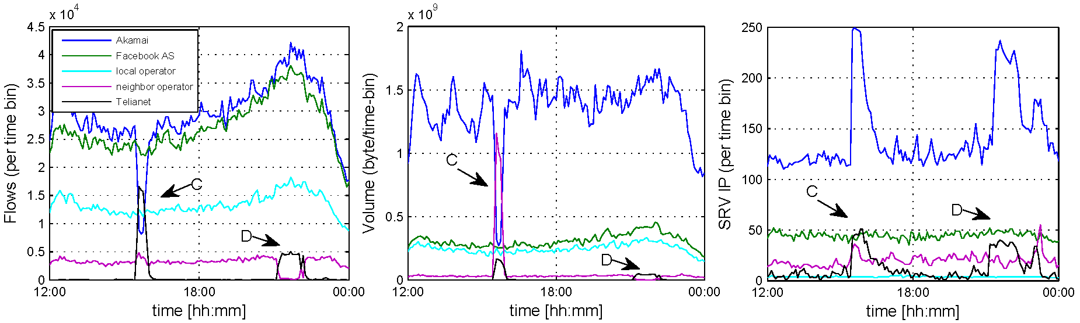
CDN Inter-play [2/3] Time Series (12 hours zoom-in)
Zoom on last 12 hours:
Event C
Outage in Akamai (drop in number of flows, served volume but NOT active IPs)
TeliaNet increases number of active IPs, served number of flows and volume
Deutsche Telekom keeps same number of active IPs, but increase served volume (takes over Akamai’s larger flows)
Event D
Akamai not involved
Swap between Deutsche Telekom and TeliaNet w.r.t. number of flows
flows
volume
srv IP

Slide 13


CDN Inter-play [3/3] Some considerations
Depending on the nature of commercial agreements for peering, it is possible that huge shifts of traffic volumes from one AS to another imply an economical loss for the ISP
Akamai
Deutsche
Telekom
TeliaNet
Events A-D reveal chain of agreements in serving contents
According to Akamai policies, it is possible that Akamai machines are installed in D.T. and TeliaNet networks (Akamai directly manages the shift)
No performance impact from user perspective (normal RTT, throughput, number of erroneous HTTP response codes)
But different commercial agreements for peering:
p2p
(free)
:(
c2p
($$$)
Local operator
TeliaNet
AS
AS
Akamai
AS
Deutsche Telekom
c2p
($$$)
AS
Topology from: http://irl.cs.ucla.edu/topology/

Slide 14
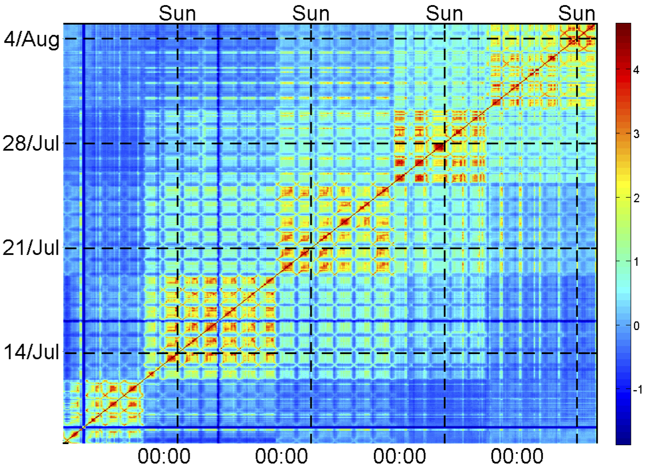
Temporal Similarity Plots (TSP) A powerfull tool to visualize temporal patterns
Discover temporal patterns and (ir)regularities in distribution timeseries
For every IP: counters of flows number and volume
Counters cumulated over different time scale (eg. 1hour)
For every time-bin: distribution of counters across IPs
Distribution compared with Kullback-Leibler metric
Comparisons plotted on heatmap (logscale)
uniform settings

Slide 15
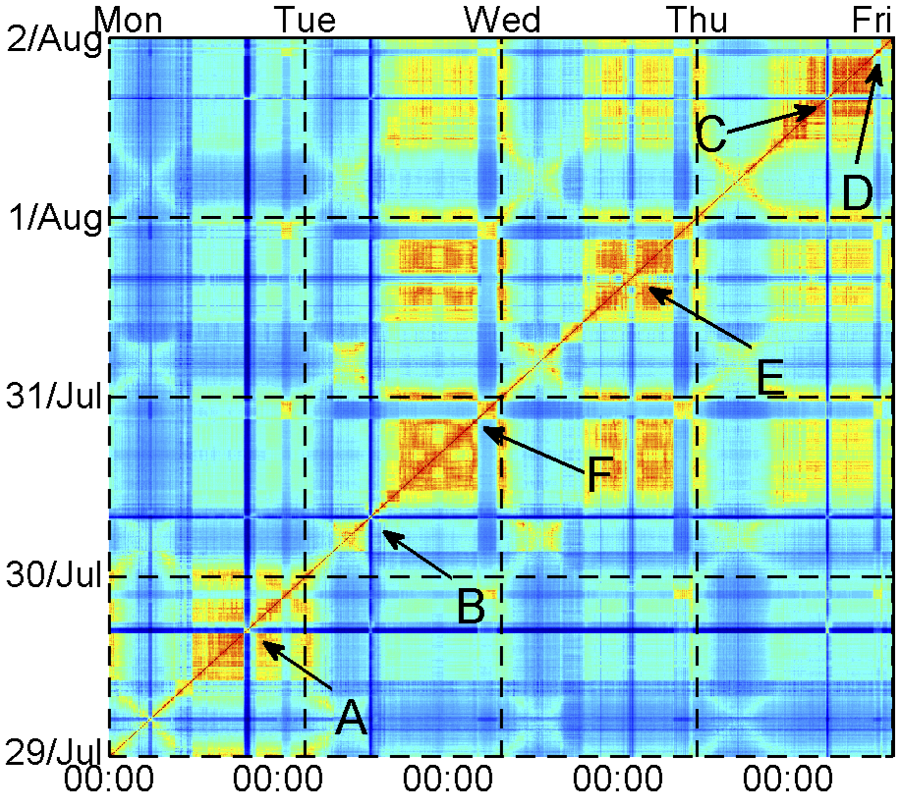
Temporal Similarity Plots (TSP) A powerfull tool to visualize temporal patterns
Zoom on unexpected events
Events A, B, C, D perfectly visible
Also new events (E, F) that were hidden in the time series

Slide 16

Concluding remarks
Characterization of Facebook traffic as seen in a operational mobile network
Quite complex hosting infrastructure
involved organizations caching an distributing contents
Number of server distributed at multiple locations
Complexity of load balancy policies
Analysis of unexpeted events
the way the traffic is served can abruptly change

Slide 17

http://www.ftw.at
http://www.ict-mplane.eu
thank you for you attention!
Acknowledgement: this work is part of the European FP-7 project mPlane
Pierdomenico Fiadino
Telecommunications Research Center of Vienna (FTW)
<fiadino@ftw.at>

Slide 18
backup slides

Slide 19
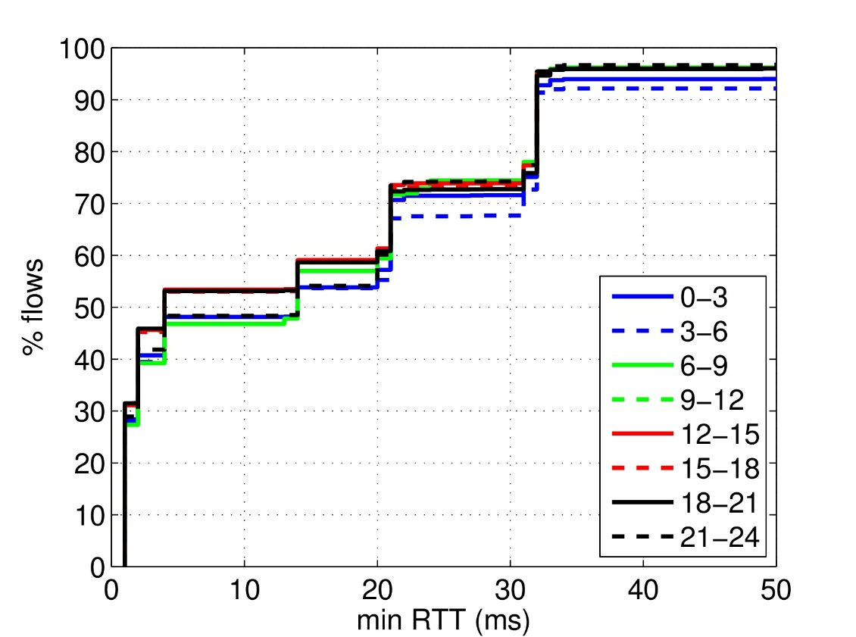
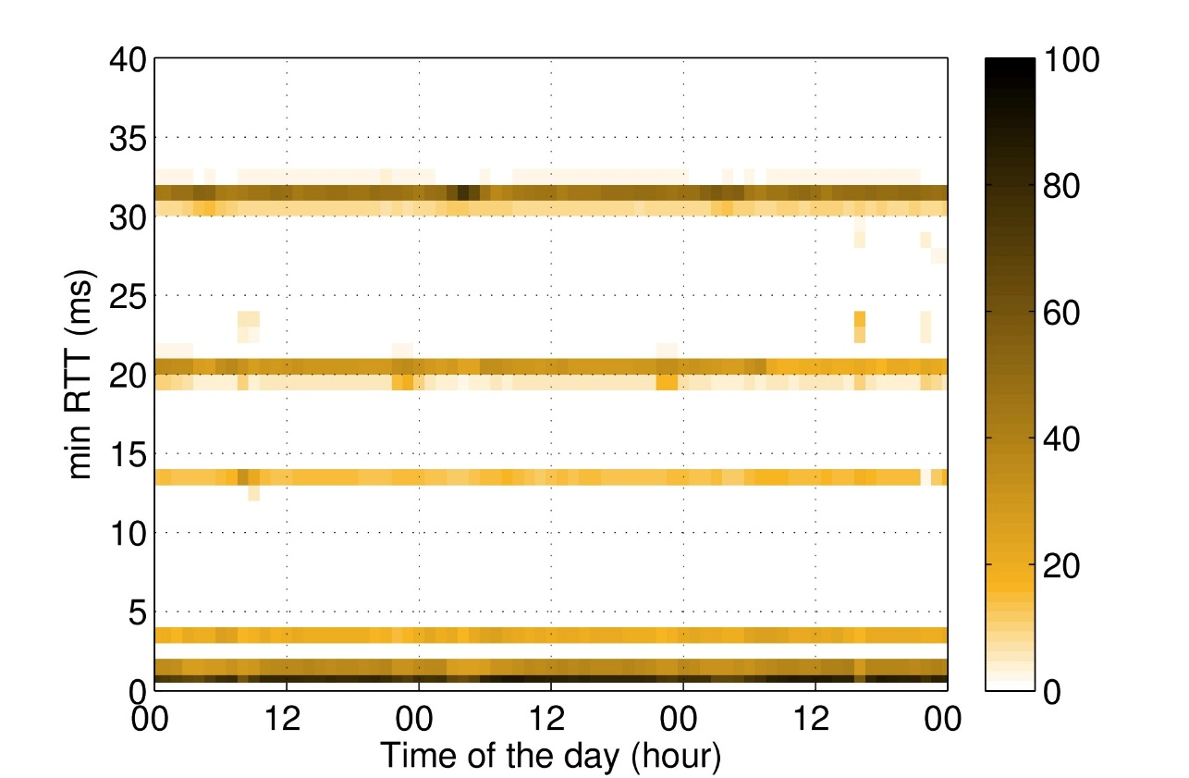
Temporal Traffic Dynamics
Now: focus on temporal evolution of the Facebook’s traffic patterns
minumum RTT daily dynamics (hourly)
minumum RTT dynamcs over 3 days
Distribution of min RTT for each 3-hours slot in a day
Rather stable, some slight variations during night and morning
Heat-map showing minRTT values observed during 3 days
Slight shifts during the first day (6am-12am at 14ms and 20ms)

Slide 20
Temporal Similarity Plots (TSP) Akamai only
Events A, B, C, D perfectly visible
Also new events (E, F) that were hidden in the time series

